Slide 1
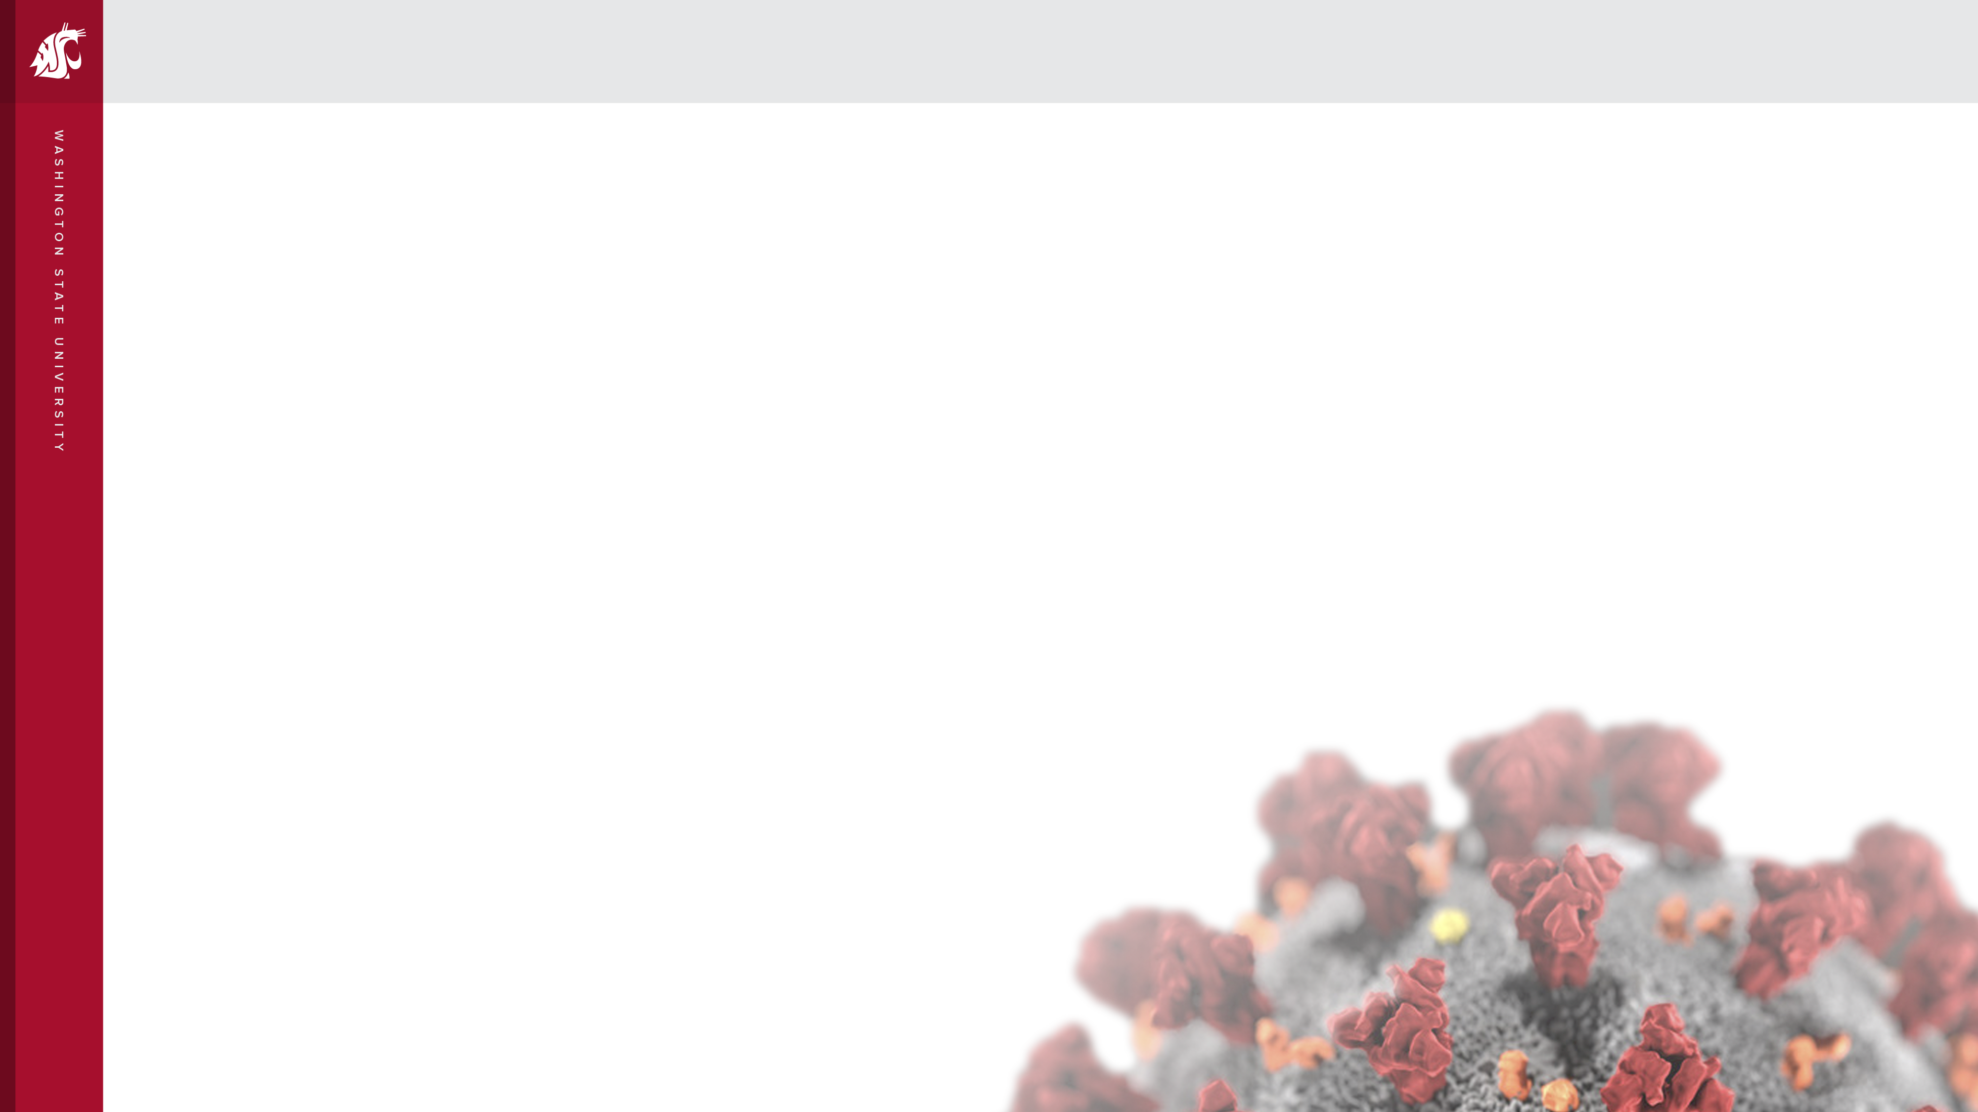
W A S H I N G T O N S T A T E U N I V E R S I T Y
SUBSTANCE USE DISORDER
PANEL DISCUSSION
WSU LEGISLATIVE & CONGRESSIONAL STAFF TOUR
Aug 9, 2023
Moderated by:
CELESTINA BARBOSA-LEIKER | Executive Vice Chancellor, WSU Health Sciences

Slide 2
Perinatal Opioid Use Disorder and Neonatal Abstinence Syndrome
Celestina Barbosa-Leiker, PhD
Executive Vice Chancellor
Washington State University Health Sciences Spokane
Funding provided by Washington State University (WSU) Health Equity Research Collaborative (HERC) (PI Barbosa-Leiker); WSU HERC (PI Burduli); HealthCare Authority (PI Barbosa-Leiker)

Slide 3

Perinatal Opioid Use
Opioid use disorder (OUD) among pregnant women in the U.S. has increased by 400% in the last decade¹
About 7% of pregnant people in the U.S. report using opioids at some point during their pregnancy²
Pregnant persons with OUD struggle with access and retention in medication-assisted treatment, leading to poorer outcomes.
The percent of pregnant people not utilizing MAT increased
  from 56% to 63% in the US from 1992-2012^{3,4}
¹Martinez, A. & Allen, A. 2020; ² Ko., J. Y., et al. 2019; ³ Martin, C. E., et al. 2015; ⁴O’Rourke-Suchoff, D., et al. 2020.
Notes:
Martinez A, Allen A. A Review of nonpharmacological adjunctive treatment for postpartum women with opioid use disorder. Addict Behav. 2020 Jun;105:106323. doi: 10.1016/j.addbeh.2020.106332. Epub 2020 Jan 20. PMID: 32036191.
Ko JY, D’Angelo DV, Haight SC, et al. Vital Signs: Prescription opioid pain reliever use during pregnancy – 34 U.S. Jurisdictions, 2019. MMWR Morb Mortal Wkly Rep 2020;69:897-903. Doi: http://dx.doi.org/10.15585/mmwr.mm6928a1.
Martin CE, Longinaker N, Terplan M. Recent Trends in treatment admissions for prescription opioid abuse during pregnancy. J of Subst Abuse Treat. 2015;48(1):37-42.
O'Rourke-Suchoff D, Sobel L, Holland E, Perkins R, Saia K, Bell S. The labor and birth experience of women with opioid use disorder: A qualitative study. Women Birth. 2020 Nove;33(6):592-597. doi: 10.1016/j.wombi.2020.01.006. Epub 2020 Jan 25. PMID: 31987751.

Slide 4

Neonatal Abstinence Syndrome
Across almost all states and demographic groups, the rate of infants diagnosed with NAS has increased by 82% from 2010-2017.¹
In 2020, every 6 per 1,000 hospital-stay newborns were diagnosed with NAS, or about 1 every 24 minutes, or 59 newborns a day.²
70-95% of infants born to women with OUD go on to develop NAS, which leads to higher risk of adverse outcomes for infants and mothers, and places increased strain on the healthcare system.³⁻⁵
¹Hirai, et al. 2017; ²HCUP 2020; ³Faherty, L. J., et al. 2021; ⁴SAMHSA; ⁵Winklbaur, B., et al. 2008.
Notes:
1. Hirai AH, Ko JY, Owens PL, Stocks C, Patrick SW. Neonatal Abstinence Syndrome and Maternal Opioid-Related Diagnoses in the US, 2010-2017. JAMA. 2021;325(2):146–155. doi:10.1001/jama.2020.24991
2. 2020 HCUP data via Data and Statistics About Opioid Use During Pregnancy (cdc.gov)
3. Faherty L.J., Heins, S., Kranz, A.M., & Stein, B.D. Postpartum Treatment for Substance Use Disorder Among Mothers of Infants with Neonatal Abstinence Syndrome and Prenatal Substance Exposure. Women's Health Reports. 2021;2(1):163-172.
4. SAHMHSA Women of Childbearing Age and Opioids (samhsa.gov)
5. Winklbaur, B., Kopf, N., Ebner, N., Jung, E., Thau, K., & Fischer, G. (2008). Treating pregnant women dependent on opioids is not the same as treating pregnancy and opioid dependence. Addiction, 103(9), 1429–1440.

Slide 5

WSU research studies
Study 1: Medication assisted treatment
  Determine barriers and facilitators for staying on medication assisted treatment during the transition from pregnancy to parenthood in women with an opioid use disorder
Study 2: Neonatal Abstinence Syndrome (NAS) nurseries
  Barriers and facilitators to establishing neonatal transitional nurseries for NAS
Study 3 (to begin 2023): Maddie’s Place assessment

Slide 6

Study 1: Medication assisted treatment
Engagement with treatment is impacted by:
Theme 1: Level of social support
Theme 2: Medication scheduling challenges
Theme 3: Motherhood as a motivator
Theme 4: Access to tangible resources
Theme 5: Connection with nonjudgmental providers

Slide 7
Theme 1: Level of social support
Limited social support was a barrier to treatment engagement…
“Well, my family, they are all in active addiction, so I had to cut my family and my friends out of my life. So that’s been difficult.”
…while increased social support was a facilitator.
“I was one of those women that was homeless and pregnant and feeling helpless and hopeless and not having the resources or the support. Having a support team has helped me tremendously. I wouldn’t have done it without a support team. And that support team includes my treatment and my family and loved ones, friends that are sober. And my kids, of course.”

Slide 8
Theme 2: Medication scheduling challenges
Logistics associated with medication scheduling were barriers to treatment engagement.
“I’m probably about forty-five minutes out of town. And transportation was a big barrier […] And then going in every day was making me so tired. I was so exhausted. You know, there was a couple times where I fell asleep at the wheel. And luckily I woke up before I even hit the ditch. You know, it – it’s hard.”

Slide 9
Theme 3: Motherhood as a motivator
A facilitator to treatment engagement was a sense of internal motivation that participants attributed to pregnancy or caring for a newborn
“I don’t think I would be as successful as I am without having a newborn. I thank my lucky stars that I’m a mom of a newborn. Only because if I didn’t have that responsibility, I don’t think I would be where I am today.”

Slide 10
Theme 4: Access to tangible resources
Improved access to resources via methadone programs were facilitators to treatment engagement.
“I’ve been able to get resources that I wouldn’t have been able to have found on my own. I’ve just been able to access a lot of resources […] being able to get free bus passes. I’ve gained a lot of support just from the resources, like my counselor...”

Slide 11
Theme 5: Connection with nonjudgmental providers
Connecting with nonjudgmental, compassionate providers was a facilitator for treatment engagement.
“Cause they don’t treat you like you’re some POS off the street on methadone. You know what I mean? They treat you like a human being with respect. I like it a lot.”
Notes:
Compassionate providers were a gateway to resources, safe pregnancy experience, transparency, education/information

Slide 12

Study 2: NAS nurseries
Ten key stakeholders from six neonatal transitional nurseries for NAS in existence in the United States participated in the interviews (founders, directors, and CEOs)
Barriers
  Licensing: struggling to determine an appropriate fit; for some it became necessary to amend existing law or establish new law. Resulted in significant delays.
  Insurance: limited receptiveness from insurance companies and varying reimbursement rates
  Financial: need to secure funding for their neonatal transitional nurseries is ever present and was particularly critical in the initial stages of establishing their nurseries

Slide 13

Study 2: NAS nurseries
Facilitators
  Political support: bipartisan enthusiasm for establishing neonatal transitional nurseries, cultivating relationships with political representatives who are advocates
  Insurance: some insurance reimbursement models were projected to be sustainable for the long-term success of the nursery
  Medical community support: engagement with local hospitals’ neonatologists; formalizing referral pathways

Slide 14
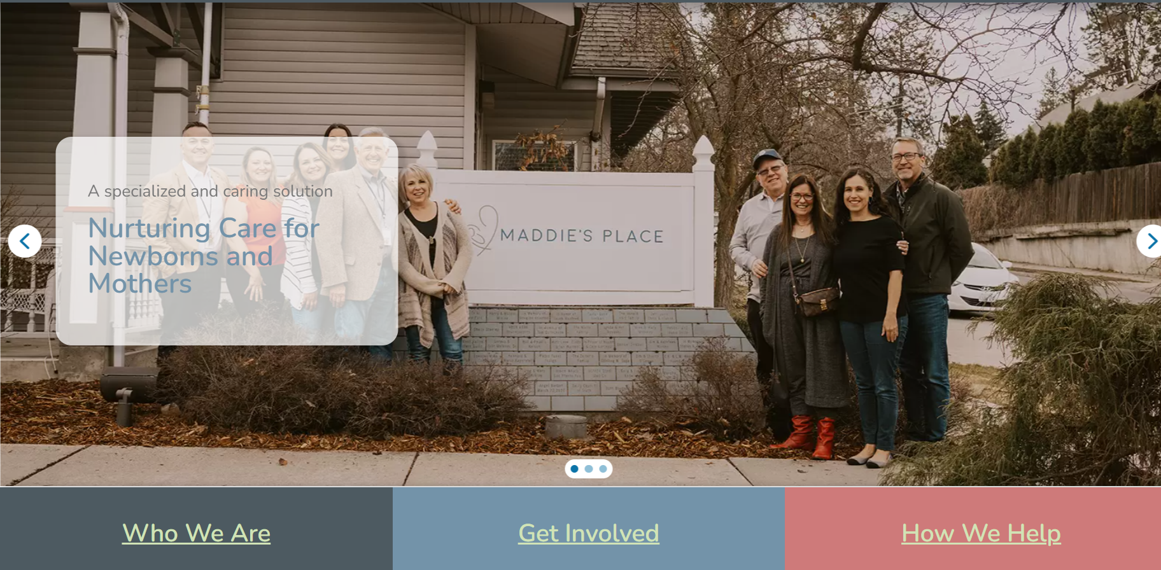
Maddie’s Place
Maddie’s Place is a 501(c)3 non-profit, free-standing recovery nursery for babies experiencing withdrawal due to prenatal substance exposure.

Slide 15

Study 3:
Maddie’s Place assessment
Report prevalence of NAS in Washington and Spokane County and identify barriers to consistent and valid reporting
Determine the health outcomes of maternal-infant dyads utilizing Maddie’s Place services
Conduct a descriptive cost analysis of NAS care at Maddie’s Place and in the state of WA

Slide 16

Thank you!
Celestina Barbosa-Leiker, PhD
celestina@wsu.edu
(509) 324-7477

Slide 17



WSUHS Interprofessional Education Efforts: Opioid Management and Treatment
Dawn E. DeWitt, MD, MSc, MACP, FRACP, FRCP-London, CMedEd, WSU Elson S. Floyd College of Medicine
Connie M. Remsberg, PharmD, PhD
WSU College of Pharmacy and Pharmaceutical Sciences

Slide 18
~$4M Grant funding has supported WSU IPE over the past 7 years
Interprofessional education (IPE) materials were created and implemented with support from:
Spokane Teaching Health Center SBIRT Student Training. Richardson BB, Bray BS, Odom-Maryon T, Purath J, Schwartz CR, Stevens KV, and Willson MN. SAHMSA. $749,922. 2015-2018.
Using Interprofessional Education to Improve Care for Patients with Multiple Chronic Conditions. Fitzgerald C, Richardson B, Willson MN, et al. HRSA, $1,102,818.
Prevention for States (PFS) Grant 5 NU17CE002734, funded by the Centers for Disease Control and Prevention (CDC)
RESPECT (HRSA) grant. DeWitt DE, Richardson B, Bray B, Remsberg C, Wilson M, Klein T, Kobayashi R, et al. [McKennon, Woods, Walker, Miller]. T0BHP33106011) ($1,929,121, 2019- 2024).
RESPECT-MAT (SAMHSA) grant. Wilson, M, et al (see above). 1H79FG000075-01 ($240,000, 2020-2022)
Notes:
Just read acronyms CDC, HRSA, and SAMHSA

Slide 19

Student initiative
Train students to care for people at risk for substance misuse through a two-part series of interprofessional education (IPE) sessions.
Began in-person and transitioned to virtual
Learning
Visit 1:
  Patient with persistent pain resulting from a car accident who was prescribed hydrocodone.
  Potential depression and multiple safety concerns (large amount of opioids, no naloxone)
Visit 2:
  Follow-up visit with patient 3 weeks following Visit 1.
  Patient requests early refill of hydrocodone, experiencing withdrawal symptoms, increased alcohol use, increased symptoms of depression
about
from
with
each other
This Photo by Unknown author is licensed under CC BY-SA.
Notes:
WHO definition: “IPE occurs when two or more professions learn with, about, and from each other to enable effective collaboration and improve health outcomes.”
IPE is not:
Students from different professions in the same lecture learning about the same topic.
Having guest lecturers from different professions within a single course.

Slide 20
~3055 RESPECT Learners so far
Participating programs:
Washington State University (lead)
Athletic training
Medicine (MD)
Nursing (BSN)
Nursing (DNP, FNP)
Dietetics, Nutrition & Exercise Physiology
Pharmacy
Eastern Washington University (lead)
Social Work
Physical Therapy
University of Washington
Medicine (MD)
Physician Assistant
Spokane Falls Community College
Addiction Studies
Pacific Northwest University of Health Sciences
Medicine (DO)
Boise State University
Social Work
Providence Paramedic Program
Interprofessional student teams from 7 institutions.
Total participants in virtual sessions:
Year | Visit 1 | Visit 2 | Notes
2019 | 312 students | Not offered | Pilot funding
2020 | 268 students | Not offered | Grant funded
2021 | 768 students | Pilot 102 students | Grant funded
2022 | 516 students | 297 students | Grant funded
2023 | 550 students | 242 students | V2 funding has expired*
Total | 2414 | 641 | Last yr of HRSA funding is 2024

Slide 21

Clinician Initiatives
Use case-based, interactive learning and team-based quality improvement methods to support interprofessional clinical teams in their efforts to provide effective pain management care for patients with pain, chronic opioid use, and/or substance use issues;
We have reached hundreds of clinicians through clinic-based and organization-based consultations and presentations

Slide 22


Wellbeing Initiatives
Support health professional wellness, especially for those in rural and other challenging settings:
  Balint wellness groups for clinicians
  Wellness session presentations for trainees and clinicians
  Finding Joy podcast (https://findingjoy.buzzsprout.com/)
  Needs assessment of rural clinicians around opioids and substance use disorder treatment

Slide 23
Our Current IPE Grant Team Members
Connie M. Remsberg, PharmD, PhD WSU College of Pharmacy and Pharmaceutical Sciences
Dawn E. DeWitt, MD, MSc, MACP, FRACP, FRCP-London, CMedEd WSU Elson S. Floyd College of Medicine
Rie Kobayashi, PhD, LMSW EWU School of Social Work
Skye McKennon, PharmD, RPh, BCPS, ACSM-GEI WSU Elson S. Floyd College of Medicine
Marian Wilson, PhD, MPH, RN, PGMT-BC WSU College of Nursing
Ross J. Bindler, PharmD WSU College of Nursing
Jennifer C. Miller, Pharm D
WSU College of Pharmacy and Pharmaceutical Sciences
Jennifer C. Anderson, BA WSU Elson S. Floyd College of Medicine
Heather Striker, RN WSU College of Nursing
Former team members: Barbara Richardson, Brenda Bray, Elizabeth Wood, Janet Walker, Tracy Klein
Notes:
We are part of an interprofessional team representing many health professions including medicine, pharmacy, nursing, and social work.

Slide 24
Pain and Substance Use:
Addressing the conundrum
Marian Wilson, PhD, MPH, RN, PMGT-BC
Washington State University College of Nursing
Associate Professor
Phone: 509-324-7443
Email: marian.wilson@wsu.edu

Slide 25

Pain promotes and reinforces substance use
Notes:
Most (>50%) U.S. adults with a Substance Use Disorder (alcohol, tobacco, cannabis, sedatives, opioids) have a comorbid chronic pain condition.
People with SUD may have limited access to pain management treatment
High need for non-pharmacologic options.
Pain is underappreciated as a trigger for substance use

Slide 26

What is the risk of Opioid Use Disorder when prescribed opioids for pain?
Rates of developing Opioid Use Disorder in adults taking opioids for chronic pain is estimated at 8%-12%.
As many as 26% of people with chronic pain exhibit misuse patterns that can be a precursor to Opioid Use Disorder.
About 60-80% of adults with Opioid Use Disorder have comorbid chronic pain.
Notes:
Misuse is often explained by pain. What increases risk for OUD?
increased opioid dose, genetics, psychiatric disorders, younger age, social/family environments, childhood trauma

Slide 27
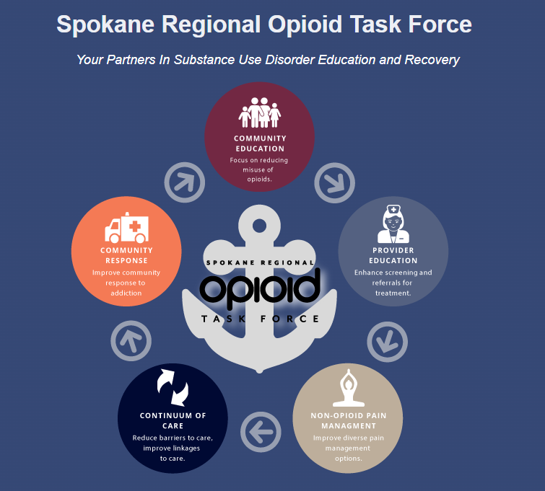
Aligning with state and local priorities
Overarching goal:
Reduce harms related to poorly managed pain and substance use by increasing access to effective pain management.
Notes:
The projects described are included in state and local plans to address pain management and reduce substance use harms

Slide 28



Study 1: The COMFORT Study
Partners:
Spokane Regional Opioid Task Force
CHAS Health
Mission:
Remove barriers and increase use of non-pharmacological pain management treatments

Slide 29

Study 1: The COMFORT Study
Outcomes
Successfully piloted 92 telehealth consultations for 16 adults with chronic pain prescribed opioids.
  Yoga Therapy (34%)
  Physical Therapy (28%)
  Massage Therapy (25%)
  Chiropractic Therapy (12%)
Pain intensity/interference and depression significantly improved from pre-test to 6-week post-test.
High satisfaction, 96% attendance.
Some reported ability to reduce opioid dose.
“These were great creative and innovative ideas that none of my doctors in the last four years have even mentioned.”

Slide 30
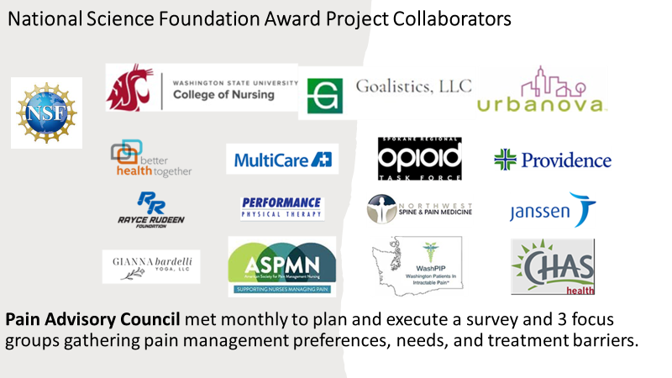
Study 2: Equalizing Access to Non-opioid Strategies with Community-embedded Online Pain Management Tools
Partners:
12 organizations
Mission:
Execute survey and focus groups to gather pain management preferences, needs, and treatment barriers for Washington State adults with pain and their health care providers.

Slide 31

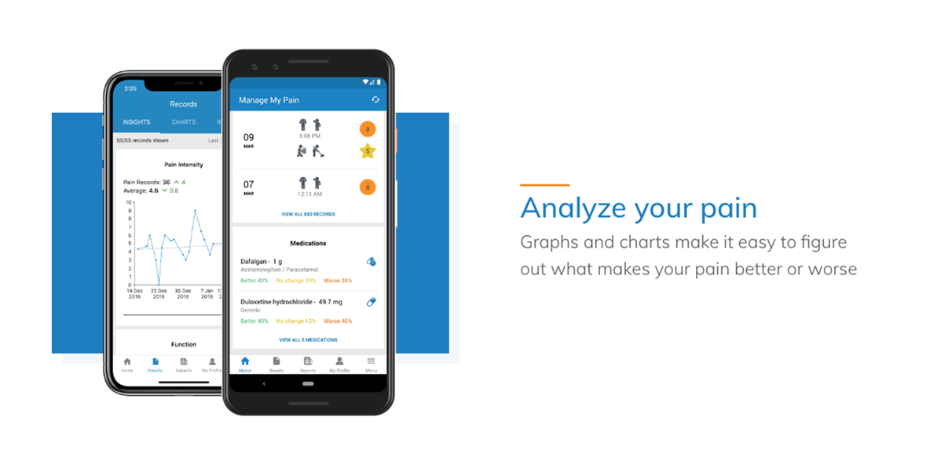

Study 2: Equalizing Access to Non-opioid Strategies with Community-embedded Online Pain Management Tools
Outcomes
  154 Washington State adult residents with pain completed the survey and 22 attended 3 focus groups along with 8 healthcare workers
  Almost all had access to a smartphone (90%), computer (75%), and/or tablet (36%).
  Nearly two-thirds reported they had not used an online resource for pain (64%) -indicating opportunities exist to innovate care using digital health solutions
National Institute on Drug Abuse
Notes:
Significant challenges/barriers to care:
Service access
Unavailable support groups, pain education, pain psychologist
Not knowing where to find services
High cost of services
Inadequate care coordination
Prescription opioid management
Lack of insurance funding for allopathic and complementary services
Massage, acupuncture, physical therapy
Pain specialists
Non-opioid options

Slide 32
Majority (60%) were dissatisfied (44%) or very dissatisfied (16%) with available pain management options
You just have to wait for months to get in for treatment and that could be really aggravating
Significant challenges/barriers to care:
  Service access
    Unavailable support groups, pain education, pain psychologist
    Not knowing where to find services
    High cost of services
    Inadequate care coordination
    Prescription opioid management
  Lack of insurance funding for services
    Massage, acupuncture, physical therapy
    Pain specialists
    Non-opioid options
I didn't even know pain psychologists existed!

Slide 33



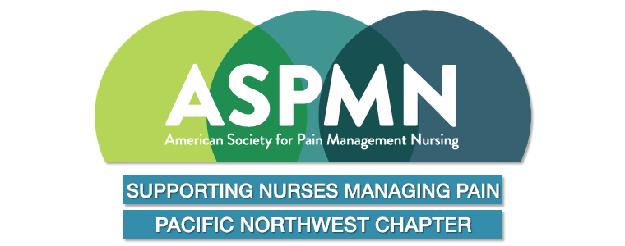
Beth Darnall, PhD
Director of Pain Relief Innovations Lab
Next steps
An evidence-based, single-session online pain class that rapidly equips patients with pain management skills.
  Research grant award 2023: Addressing pain care inequities with Empowered ReliefTM: A randomized controlled trial

Slide 34



Related work and partners
WSU Elson S. Floyd College of Medicine PRISM lab
National Cancer Institute/National Institute on Drug Abuse
Association between cannabis and pain outcomes in a Tribally operated clinic.
WSU College of Pharmacy/Pharmaceutical Sciences
National Institute on Drug Abuse/F31 student fellowship
Role of cannabinoids in drug-drug interactions with the major opioid, hydrocodone
WSU Sleep and Performance Research Center
National Institute of Nursing Research/Rayce Rudeen Foundation
Wilson, M. et al. (2023). Piloting smart home sensors to detect overnight respiratory and withdrawal symptoms in adults prescribed opioids. Pain Management Nursing, 24(1), 4-11.
National Institute of Complementary and Integrative Health
Wilson, M. et al. (2022). Pain catastrophizing mediates the relationship between pain intensity and sleep disturbances in U.S. Veterans with chronic pain. Military Medicine, 188(7-8).

