Slide 1
LEADING THE RELIABLE ENERGY FUTURE
Premiere Research | Hands-on Learning | Community-oriented
Notes:
Remember to hit the reset button to make sure all the page elements react properly.
There are 20 different layouts that you can choose from.

Slide 2
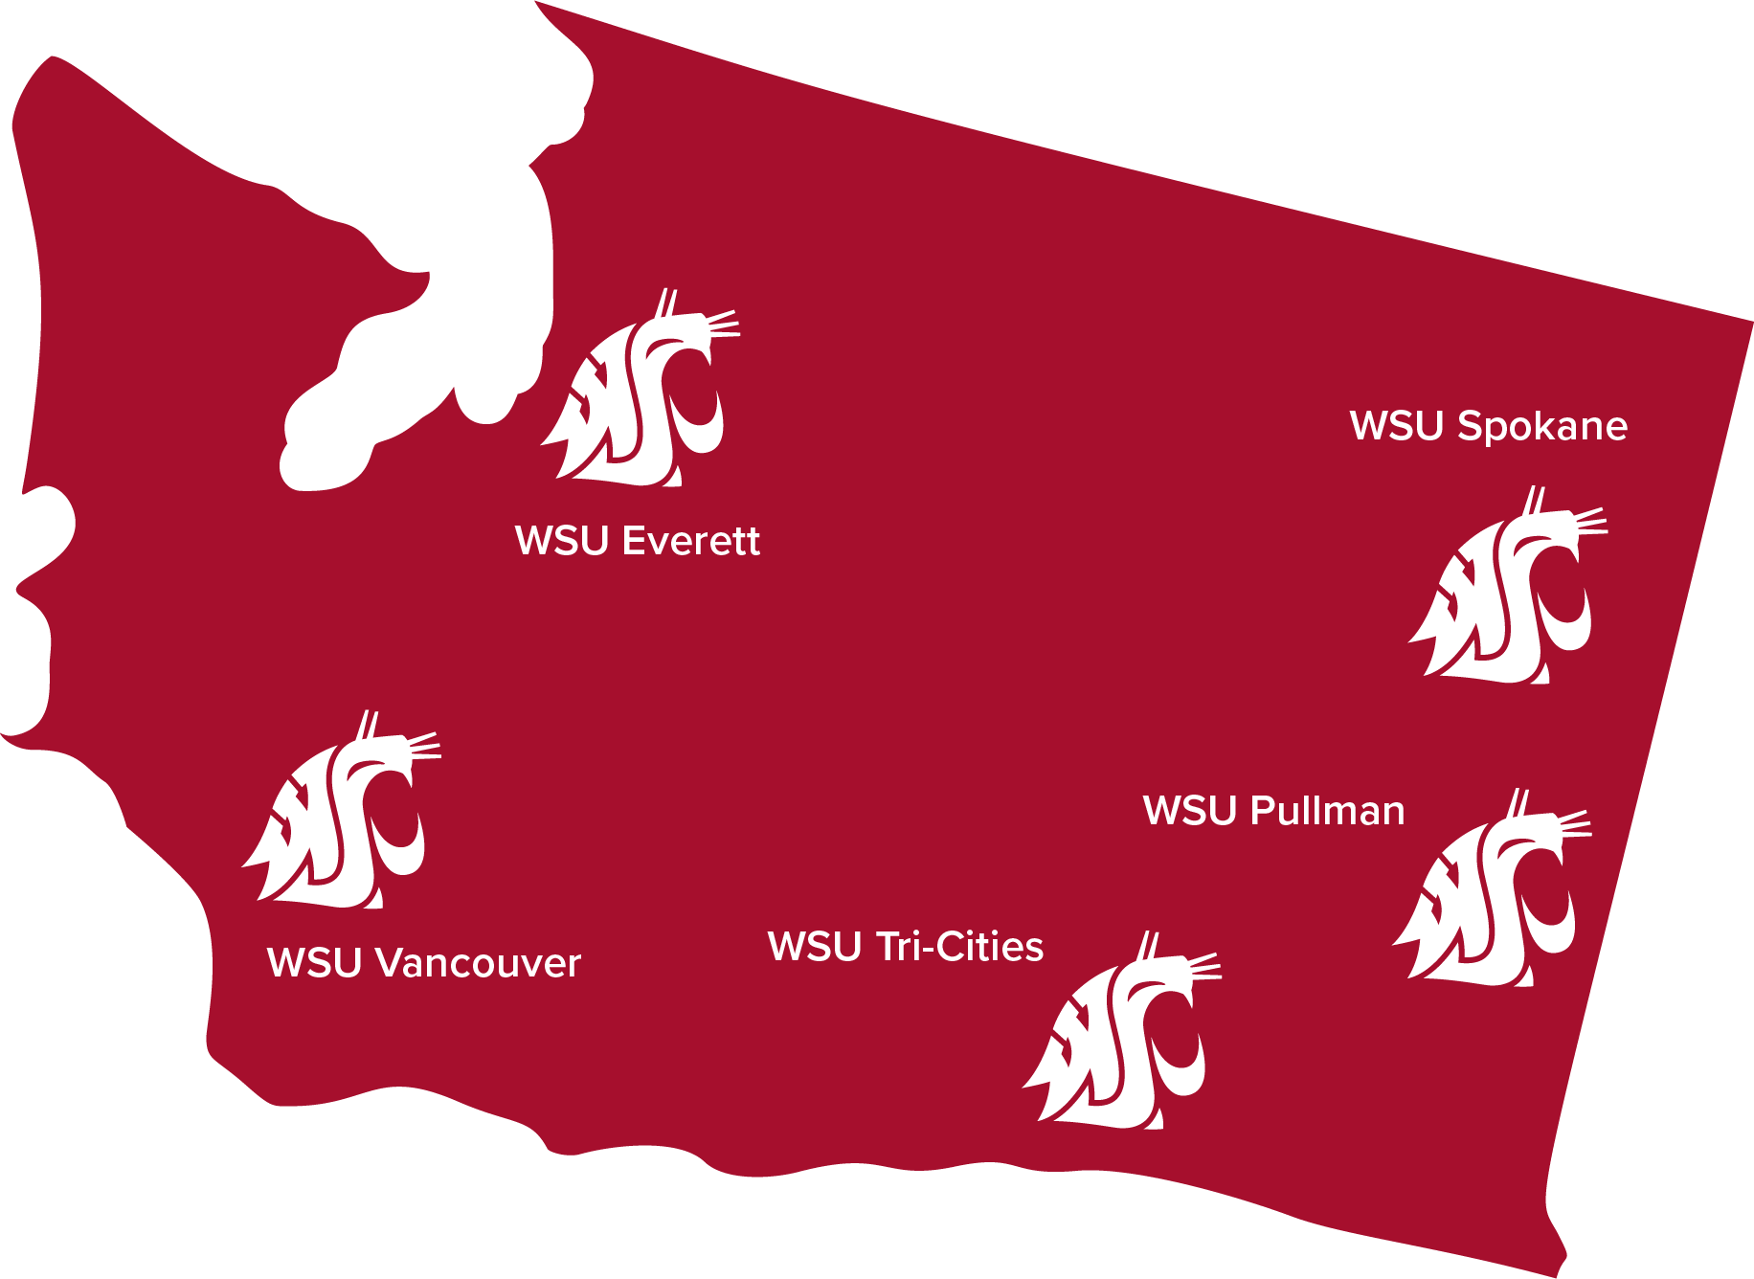

1 of 6 WSU campuses statewide
WSU is a land-grant university
We serve the entire state of Washington through:
Education
Research
Community service and partnerships
WSU Global
Notes:
WSU is a land-grant university, meaning we serve the entire state of Washington through:
Education
Research
Community service and partnerships
Map of Washington state with campus locations:
WSU Everett
WSU Pullman
WSU Spokane
WSU Tri-Cities
WSU Vancouver
WSU Global (online campus)

Slide 3
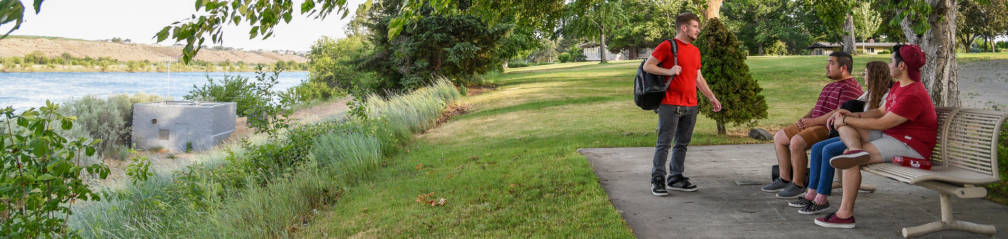
Feel right at home
Campus
reflects the community
47%
of students are the first in their families to attend college
15:1
student-to-faculty ratio = personalized support
Average student age - 24 years old
20+ Bachelor’s Degrees 30+ Graduate Degrees

Slide 4
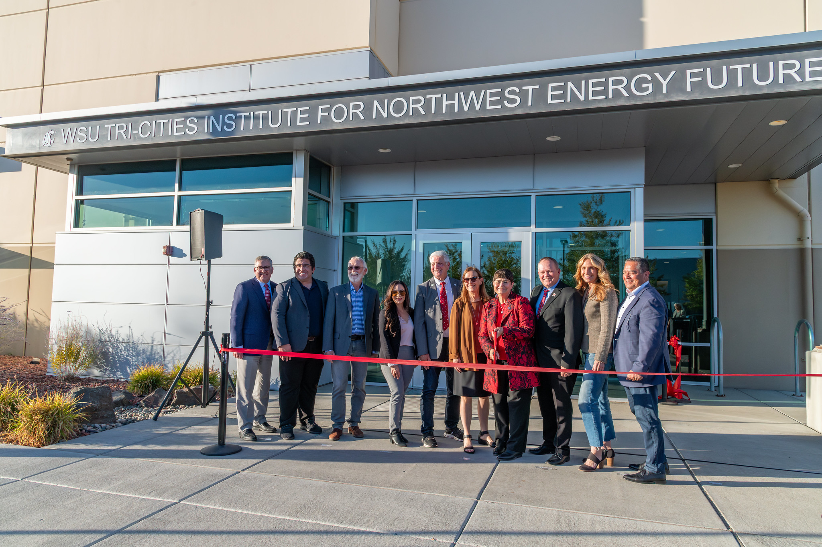
Advancing reliable energy and environmental solutions
Institute for Northwest Energy Futures ( INEF)
Top researchers working alongside local energy stakeholders
Understanding the interplay between emerging technology and current energy systems
Economic impacts of change on energy public policy

Slide 5
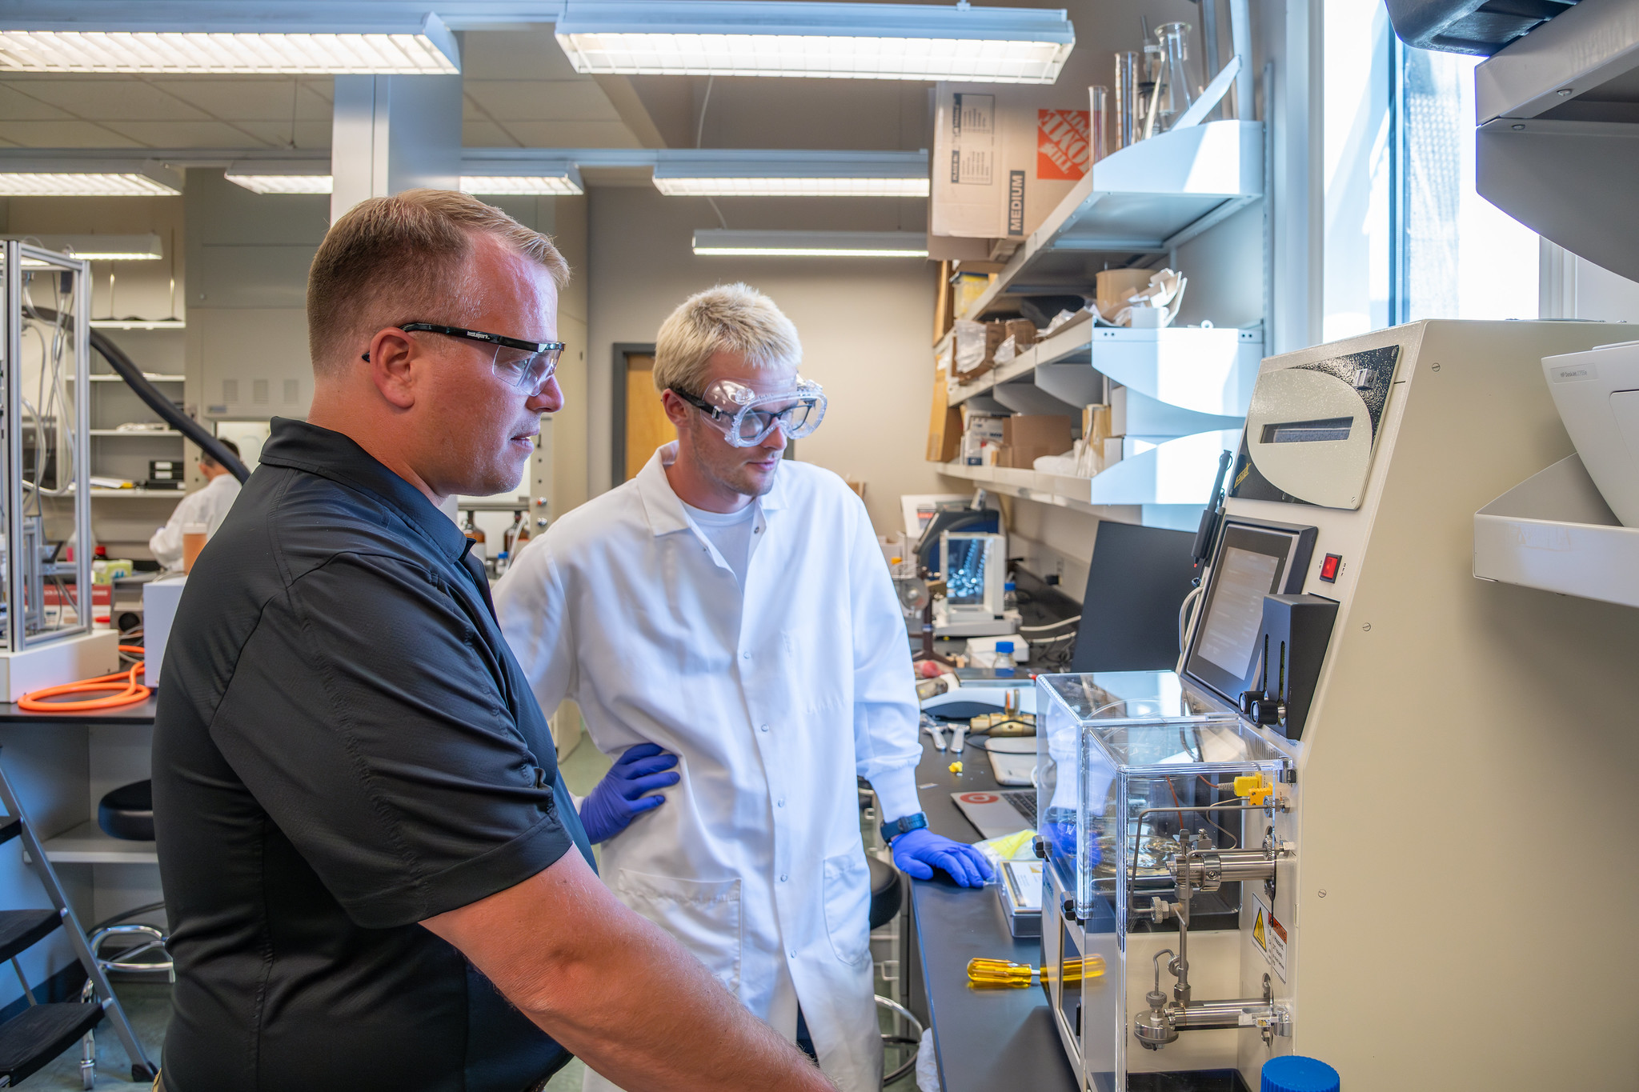
Advancing reliable energy and environmental solutions
Bioproducts Science & Engineering Laboratory (BSEL)
Joint venture with PNNL
Student and scientist collaboration
Key play in SAF
Conducts research on:
Biochemicals
Biomaterials
Bioprocesses
Bioenergy and bioproducts engineering

Slide 6
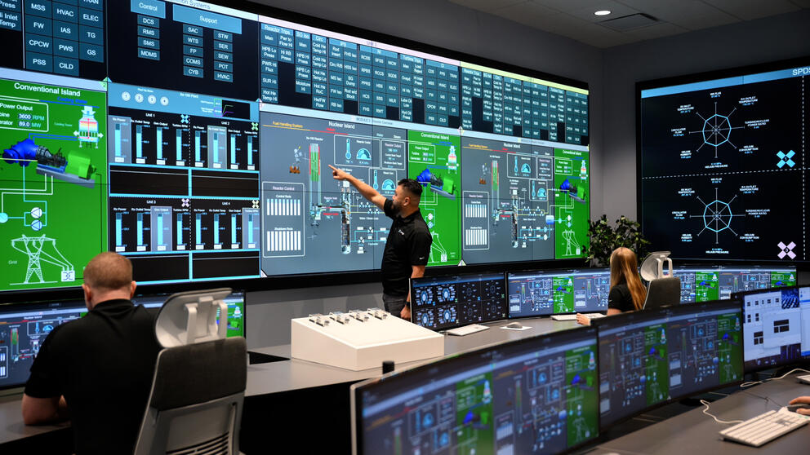
Advancing reliable energy and environmental solutions
Nuclear Engineering
Graduate certificates in nuclear materials, science and engineering
Local partners sponsor senior design projects offer internships
SMR control room simulator coming this fall

Slide 7
